Slide 1
Divide and Conquer-2
Lecture-3: Maximum Subarray Sum Problem
Md. Golam Shahriar,
Lecturer, Dept. of CSE, VU

Slide 2
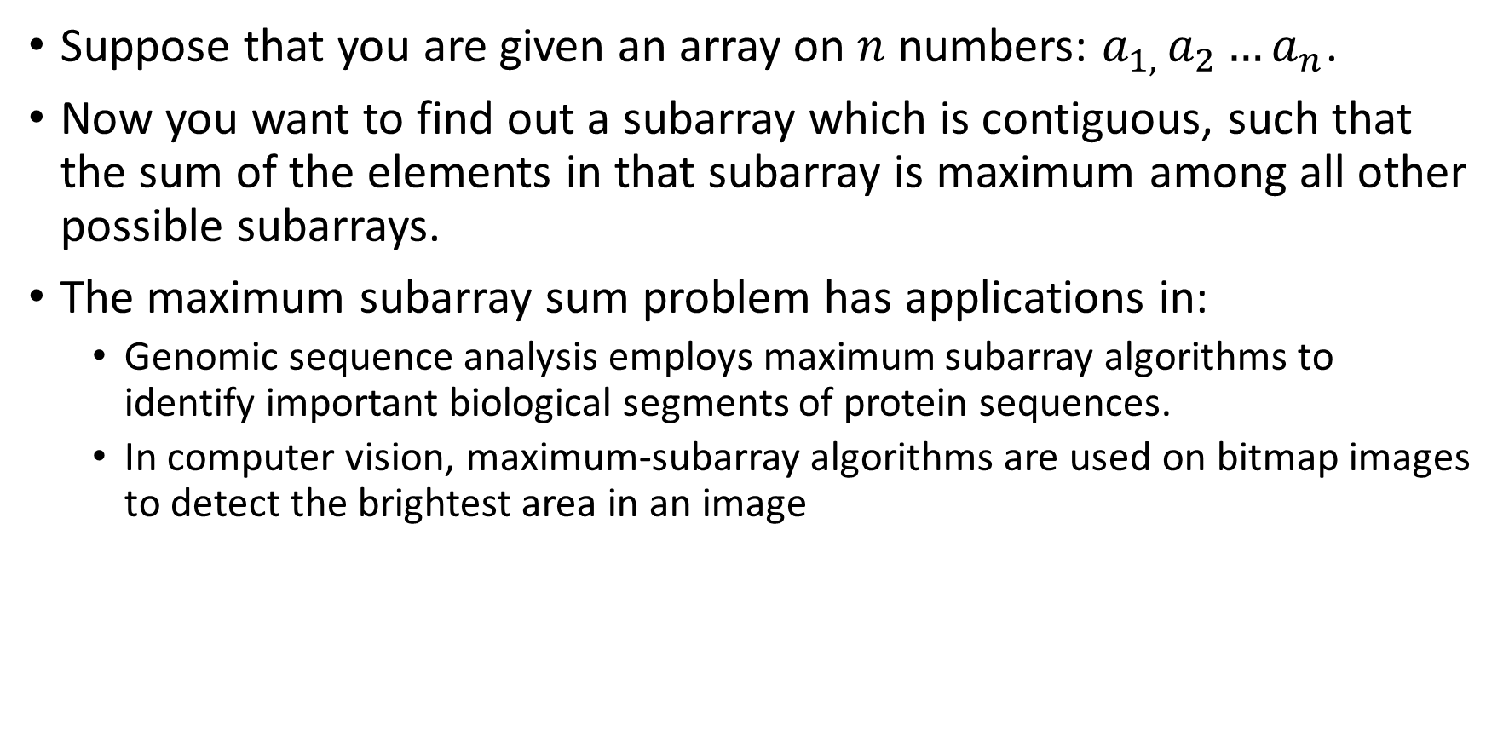
The Maximum Subarray Sum Problem
Suppose that you are given an array on $n$ numbers: $a_{1, }a_{2}…a_{n}$.
Now you want to find out a subarray which is contiguous, such that the sum of the elements in that subarray is maximum among all other possible subarrays.
The maximum subarray sum problem has applications in:
Genomic sequence analysis employs maximum subarray algorithms to identify important biological segments of protein sequences.
In computer vision, maximum-subarray algorithms are used on bitmap images to detect the brightest area in an image

Slide 3
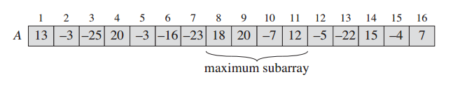

An Example of The Problem
Suppose that we are given an array $A$ of length 16.
The maximum subarray here occurs from $A[8]$ to $A[11]$ with sum of 43.

Slide 4
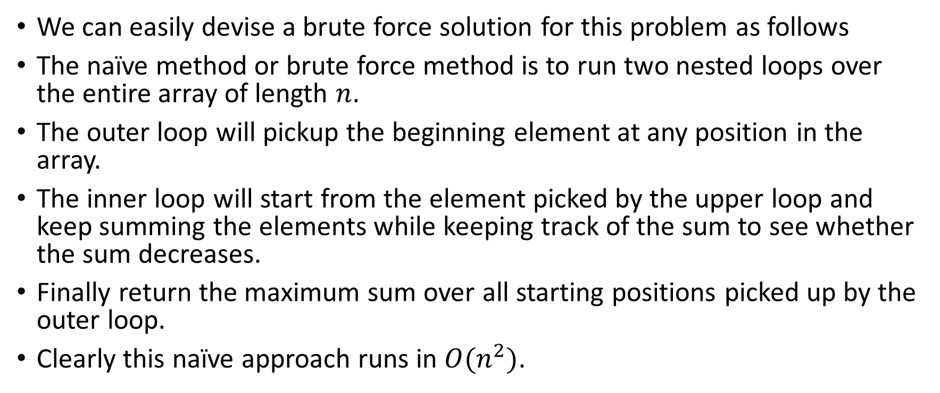
A Brute Force Solution
We can easily devise a brute force solution for this problem as follows
The naïve method or brute force method is to run two nested loops over the entire array of length $n$.
The outer loop will pickup the beginning element at any position in the array.
The inner loop will start from the element picked by the upper loop and keep summing the elements while keeping track of the sum to see whether the sum decreases.
Finally return the maximum sum over all starting positions picked up by the outer loop.
Clearly this naïve approach runs in $O(n^{2})$.

Slide 5
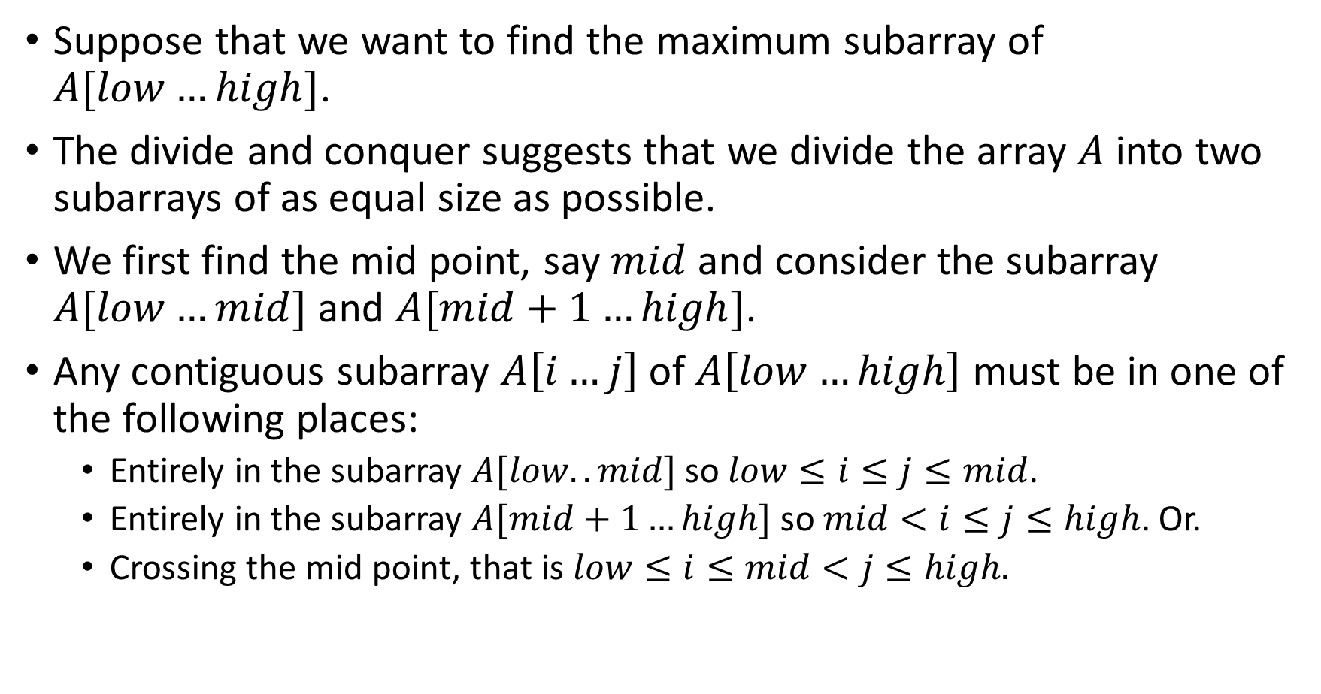
A Solution Using Divide and Conquer Approach
Suppose that we want to find the maximum subarray of $A[low…high]$.
The divide and conquer suggests that we divide the array $A$ into two subarrays of as equal size as possible.
We first find the mid point, say $mid$ and consider the subarray $A[low…mid]$ and $A[mid+1…high]$.
Any contiguous subarray $A\left[i…j\right]$of $A\left[low…high\right]$ must be in one of the following places:
Entirely in the subarray $A[low..mid]$ so $low≤i≤j≤mid$.
Entirely in the subarray $A[mid+1…high]$ so $mid<i≤j≤high$. Or.
Crossing the mid point, that is $low≤i≤mid<j≤high.$

Slide 6
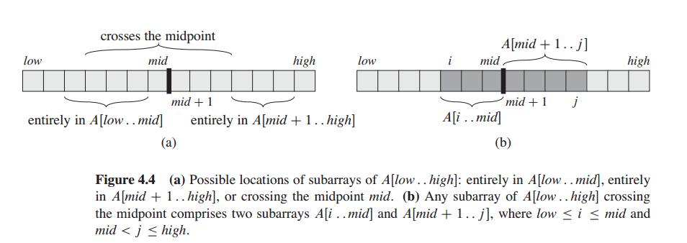

Slide 7
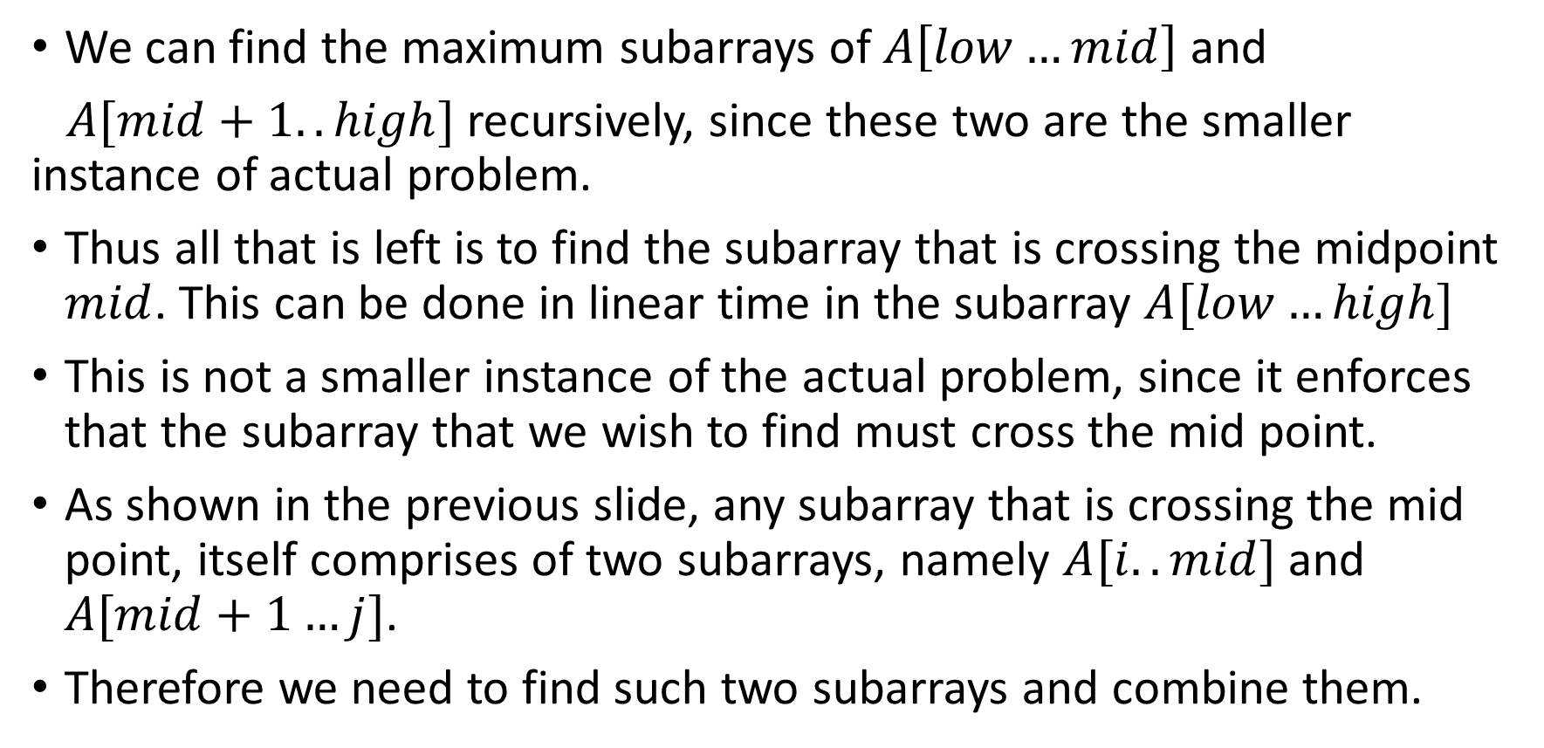
A Solution Using Divide and Conquer Approach(Continued)
We can find the maximum subarrays of $A\left[low…mid\right]$ and
$A[mid+1..high]$ recursively, since these two are the smaller instance of actual problem.
Thus all that is left is to find the subarray that is crossing the midpoint $mid$. This can be done in linear time in the subarray $A[low…high]$
This is not a smaller instance of the actual problem, since it enforces that the subarray that we wish to find must cross the mid point.
As shown in the previous slide, any subarray that is crossing the mid point, itself comprises of two subarrays, namely $A[i..mid]$ and $A[mid+1…j]$.
Therefore we need to find such two subarrays and combine them.

Slide 8

An Algorithm for Finding the Maximum Subarray Crossing the Mid Point.
Find-Max-Crossing-Subarray($A, low, mid, high$)
1. left-sum $≔$ $−∞$
$sum$ $≔$ 0
for $i ≔ mid$ downto $low$ do
$sum ≔ sum + A[i]$
if $sum >$ left-sum then
left-sum $≔ sum$
max-left $≔ i$
end
end
right-sum $≔ −∞$
$sum ≔0$
for $j ≔ mid + 1$ to $high$ do
$sum ≔ sum + A[j]$
if $sum >$ right-sum then
right-sum$≔ sum$
max-right$≔ j$
end
end
return (max-left, max-right, right-sum $+$left-sum)

Slide 9
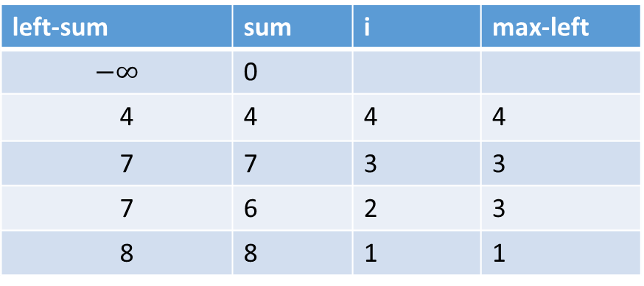

A Snapshot of the Execution of the Previous Algorithm
$A=$
For left part:
1 | 2 | 3 | 4 | 5 | 6 | 7 | 8
2 | -1 | 3 | 4 | 1 | -3 | -6 | 5
left-sum | sum | i | max-left
$$−∞$$ | 0
4 | 4 | 4 | 4
7 | 7 | 3 | 3
7 | 6 | 2 | 3
8 | 8 | 1 | 1

Slide 10
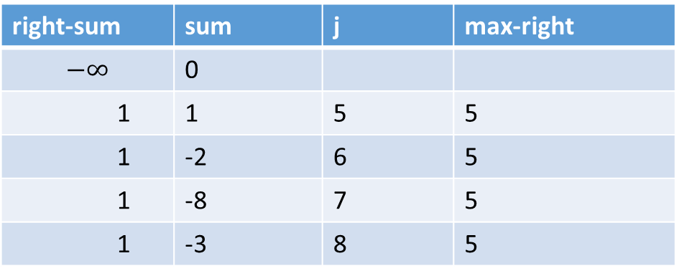

A Snapshot of the Execution of the Previous Algorithm
$A=$
For right part:
1 | 2 | 3 | 4 | 5 | 6 | 7 | 8
2 | -1 | 3 | 4 | 1 | -3 | -6 | 5
right-sum | sum | j | max-right
$$−∞$$ | 0
1 | 1 | 5 | 5
1 | -2 | 6 | 5
1 | -8 | 7 | 5
1 | -3 | 8 | 5

Slide 11
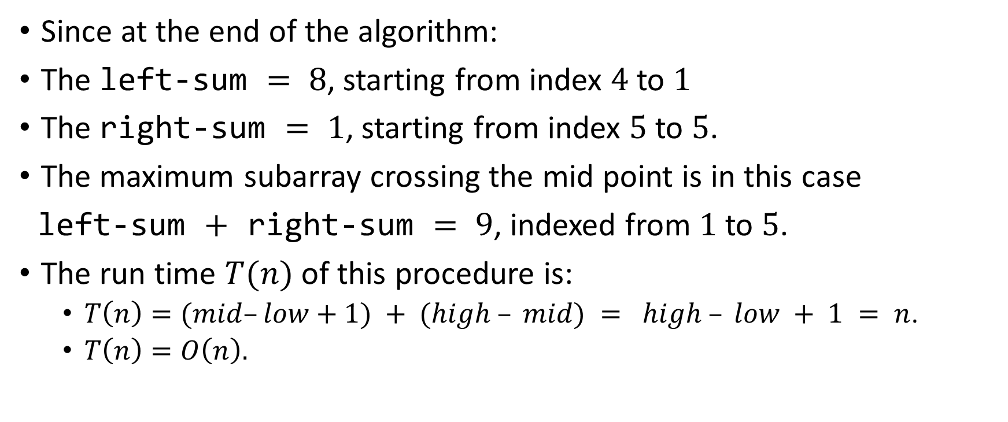
The Maximum Possible Subarray From the Previous Array.
Since at the end of the algorithm:
The left-sum $= 8$, starting from index $4$ to $1$
The right-sum $= 1$, starting from index $5$ to $5$.
The maximum subarray crossing the mid point is in this case
left-sum $+$ right-sum $= 9$, indexed from $1$ to $5$.
The run time $T(n)$ of this procedure is:
$T\left(n\right)=(mid–low+1) + (high – mid) = high – low + 1 = n$.
$T\left(n\right)=O\left(n\right).$

Slide 12
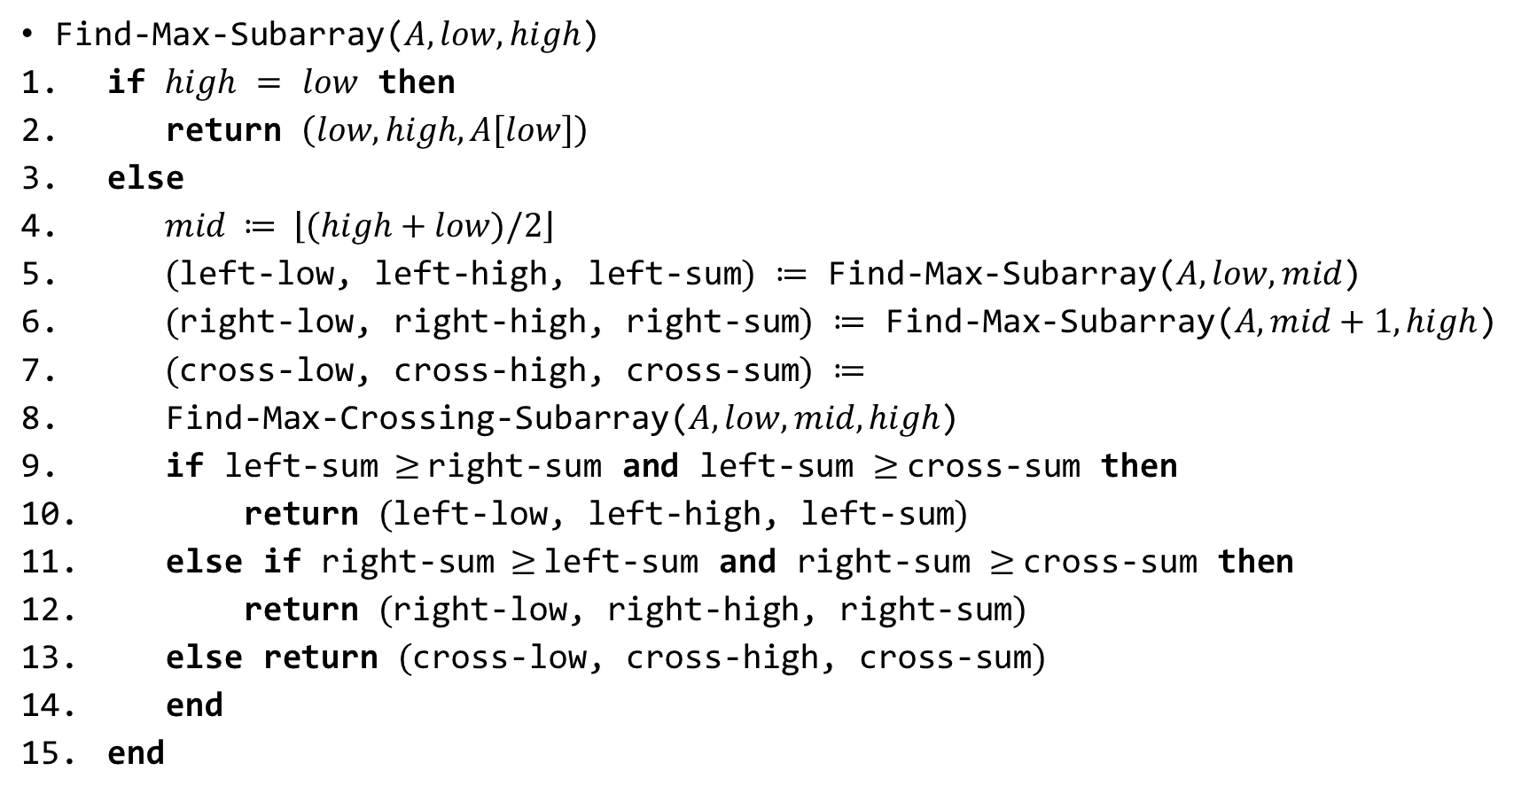
The Algorithm for Other Two Halves.
Find-Max-Subarray($A, low, high$)
if $high$ $=$ $low$ then
return $\left(low, high, A\left[low\right]\right)$
else
$mid ≔ \left\lfloor (high+low)/2\right\rfloor$
$($left-low, left-high, left-sum$)$ $≔$ Find-Max-Subarray($A, low, mid$)
$($right-low, right-high, right-sum$)$ $≔$ Find-Max-Subarray($A,mid+1,high$)
$($cross-low, cross-high, cross-sum$)$ $≔$
Find-Max-Crossing-Subarray($A, low, mid, high$)
if left-sum$≥$right-sum and left-sum $≥$cross-sum then
return $($left-low, left-high, left-sum$)$
else if right-sum$≥$left-sum and right-sum $≥$cross-sum then
return $($right-low, right-high, right-sum$)$
else return $($cross-low, cross-high, cross-sum$)$
end
end

Slide 13
1 | 2 | 3 | 4 | 5 | 6 | 7 | 8
2 | -1 | 3 | 4 | 1 | -3 | -6 | 5
Low=1
High=8
Mid=4

Slide 14
1 | 2 | 3 | 4 | 5 | 6 | 7 | 8
2 | -1 | 3 | 4 | 1 | -3 | -6 | 5
Low=1
High=8
Mid=4
1(low) | 2(mid) | 3 | 4(high)
2 | -1 | 3 | 4
5(low) | 6(mid) | 7 | 8(high)
1 | -3 | -6 | 5

Slide 15
1 | 2 | 3 | 4 | 5 | 6 | 7 | 8
2 | -1 | 3 | 4 | 1 | -3 | -6 | 5
Low=1
High=8
Mid=4
1(low) | 2(mid) | 3 | 4(high)
2 | -1 | 3 | 4
5(low) | 6(mid) | 7 | 8(high)
1 | -3 | -6 | 5
1(low)(mid) | 2(high)
2 | -1
3(low)(mid) | 4(high)
3 | 4
5(low)(mid) | 6(high)
1 | -3
7(low)(mid) | 8(high)
-6 | 5

Slide 16
1 | 2 | 3 | 4 | 5 | 6 | 7 | 8
2 | -1 | 3 | 4 | 1 | -3 | -6 | 5
Low=1
High=8
Mid=4
1(low) | 2(mid) | 3 | 4(high)
2 | -1 | 3 | 4
5(low) | 6(mid) | 7 | 8(high)
1 | -3 | -6 | 5
1(low)(mid) | 2(high)
2 | -1
3(low)(mid) | 4(high)
3 | 4
5(low)(mid) | 6(high)
1 | -3
7(low)(mid) | 8(high)
-6 | 5
1(base)
2
2(base)
-1
3(base)
3
4(base)
4
5(base)
1
6(base)
-3
7(base)
-6
8(base)
5

Slide 17
1 | 2 | 3 | 4 | 5 | 6 | 7 | 8
2 | -1 | 3 | 4 | 1 | -3 | -6 | 5
Low=1
High=8
Mid=4
(1,5,9)
(1,4,8)
(8,8,5)
1(low) | 2(mid) | 3 | 4(high)
2 | -1 | 3 | 4
5(low) | 6(mid) | 7 | 8(high)
1 | -3 | -6 | 5
(1,1,2)
(3,4,7)
(5,5,1)
(8,8,5)
1(low)(mid) | 2(high)
2 | -1
3(low)(mid) | 4(high)
3 | 4
5(low)(mid) | 6(high)
1 | -3
7(low)(mid) | 8(high)
-6 | 5
1(base)
2
2(base)
-1
3(base)
3
4(base)
4
5(base)
1
6(base)
-3
7(base)
-6
8(base)
5
(1, 1, 2)
(2, 2, -1)
(3, 3, 3)
(4, 4, 4)
(5, 5, 1)
(6, 6, -3)
(7, 7, -6)
(8, 8, 5)

Slide 18
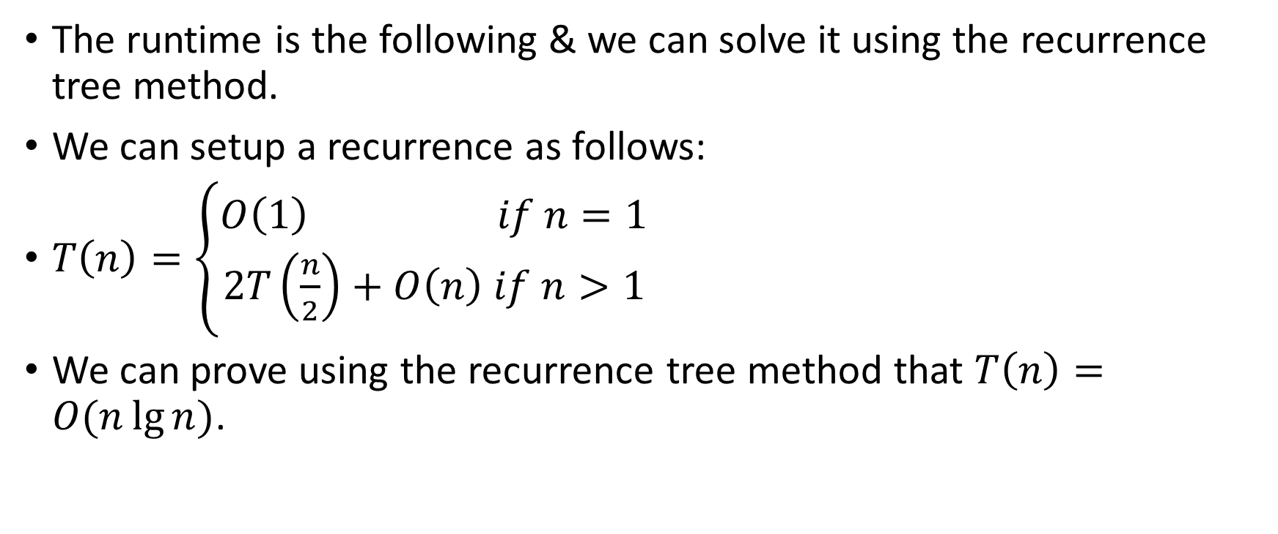
The Runtime Analysis.
The runtime is the following & we can solve it using the recurrence tree method.
We can setup a recurrence as follows:
$T\left(n\right)=\left\{\begin{aligned}O\left(1\right) if n=1 \\ 2T\left(\frac{n}{2}\right)+O\left(n\right) if n>1\end{aligned}\right.$
We can prove using the recurrence tree method that $T\left(n\right)=O(n\lg{n})$.

Slide 19
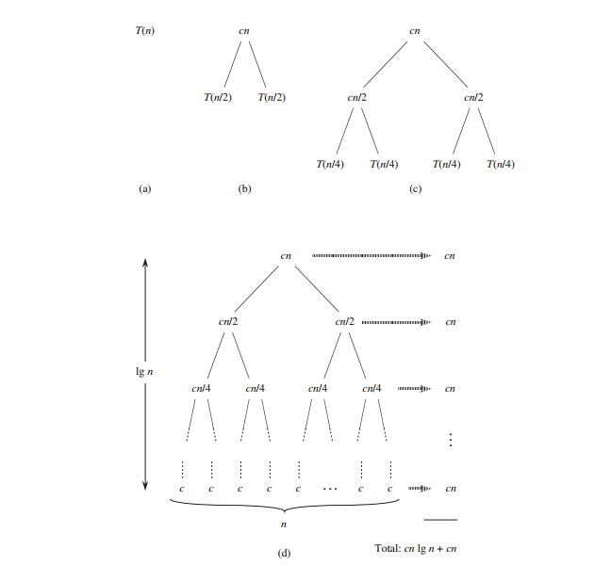

Slide 20
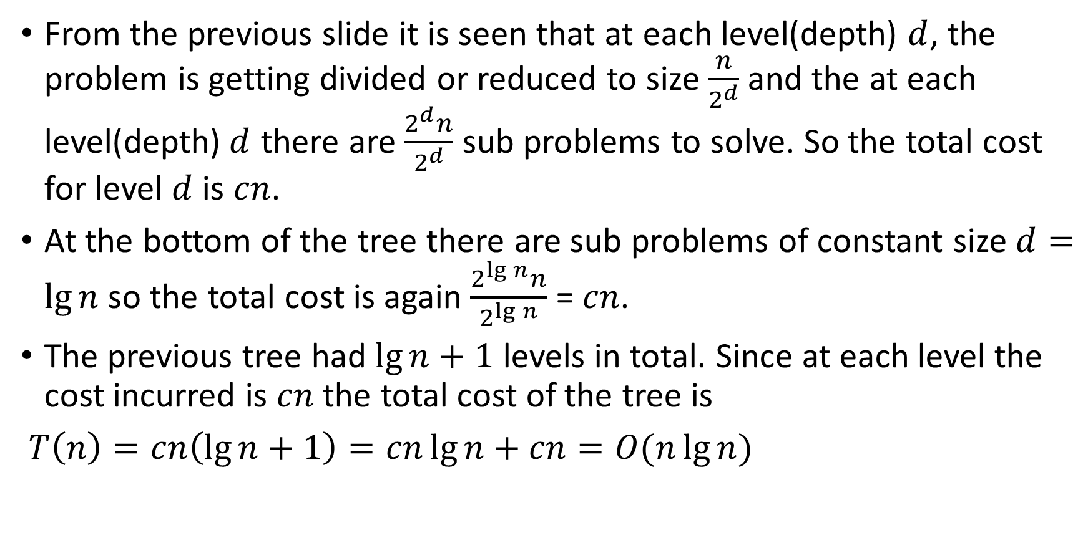
The Runtime Analysis.
From the previous slide it is seen that at each level(depth) $d$, the problem is getting divided or reduced to size $\frac{n}{2^{d}}$ and the at each level(depth)$d$ there are $\frac{2^{d}n}{2^{d}}$ sub problems to solve. So the total cost for level $d$ is $cn$.
At the bottom of the tree there are sub problems of constant size $d=\lg{n}$ so the total cost is again $\frac{2^{\lg{n}}n}{2^{\lg{n}}}$ = $cn$.
The previous tree had $\lg{n+}$ $1$ levels in total. Since at each level the cost incurred is $cn$ the total cost of the tree is
$T\left(n\right)=cn\left(\lg{n}+1\right)=cn\lg{n}+cn=O(n\lg{n})$

